Slide 1
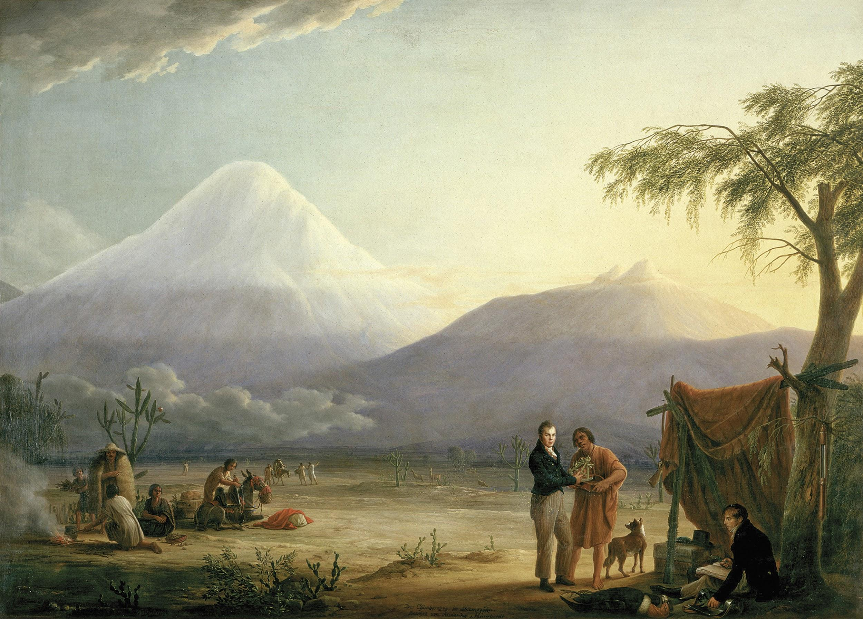
Alexander von Humboldt

Slide 2
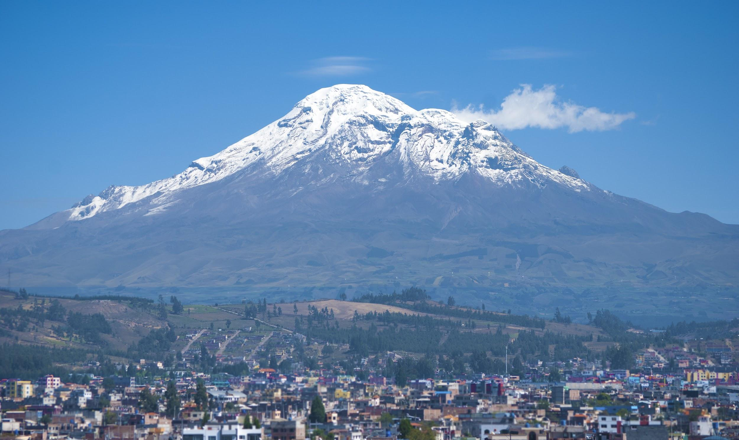
Warm-up
Who is Alexander von Humboldt? What did he do in 1802?
What happened to the vegetation on Mount Chimborazo after 210 years?
What caused this change to occur?

Slide 3
Quito Climate data (temp and precip)
We have climate data from Ecuador starting in 1866. Since that time, records indicate an increase in mean annual temperature of 1.46°C.
In addition, data shows an increase in mean temperatures globally of 0.26°C from 1802 through 1866.
We can estimate a total temperature increase from the time of Humboldt’s expedition to be 1.72°C (3.1°F)
Retrieved from http://berkeleyearth.lbl.gov/regions/ecuador

Slide 4
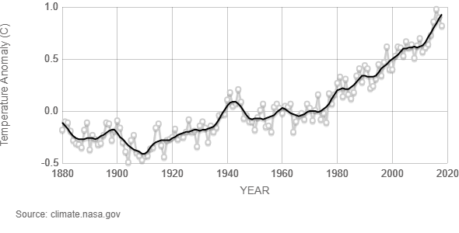
Global temperature increase (1880-2018)

Slide 5
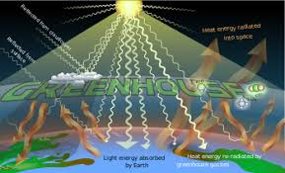
What causes global temperature increase?
More greenhouse gases entering our atmosphere traps more and more heat which causes Earth to warm.

Slide 6
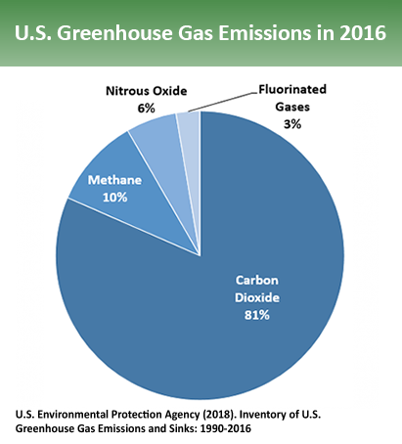
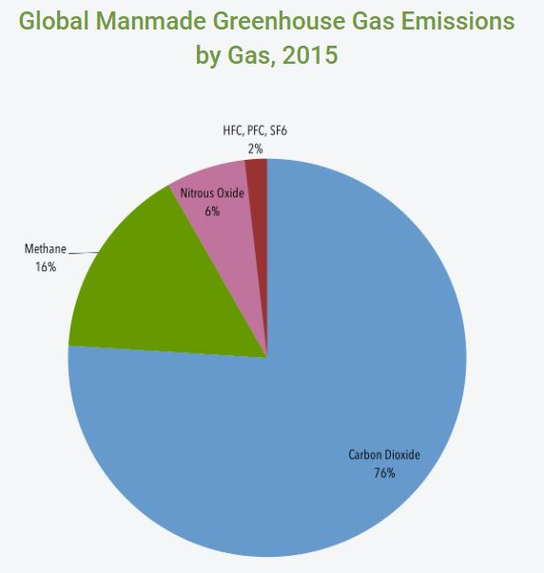
Main greenhouse gas contributors

Slide 7
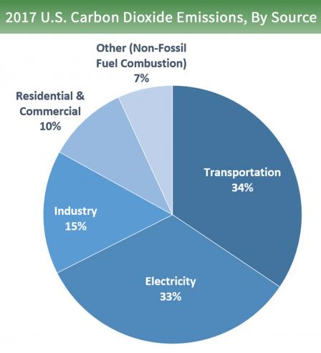
Carbon Dioxide (CO2) and Methane (CH4) are the two main contributors
What are some human activities that cause such high levels of CO₂ and CH₄ to be emitted into our atmosphere?

Slide 8
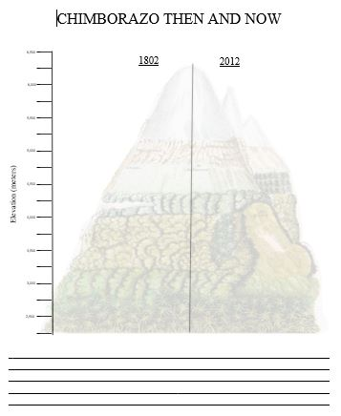
On the bottom of your Chimborazo graph…
Write a paragraph (3-5 sentences) explaining why the vegetation on Chimborazo is shifting upward.
Be sure to include:
The two research studies conducted on Chimborazo
Plant data
Climate data

Slide 9
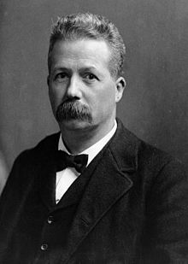
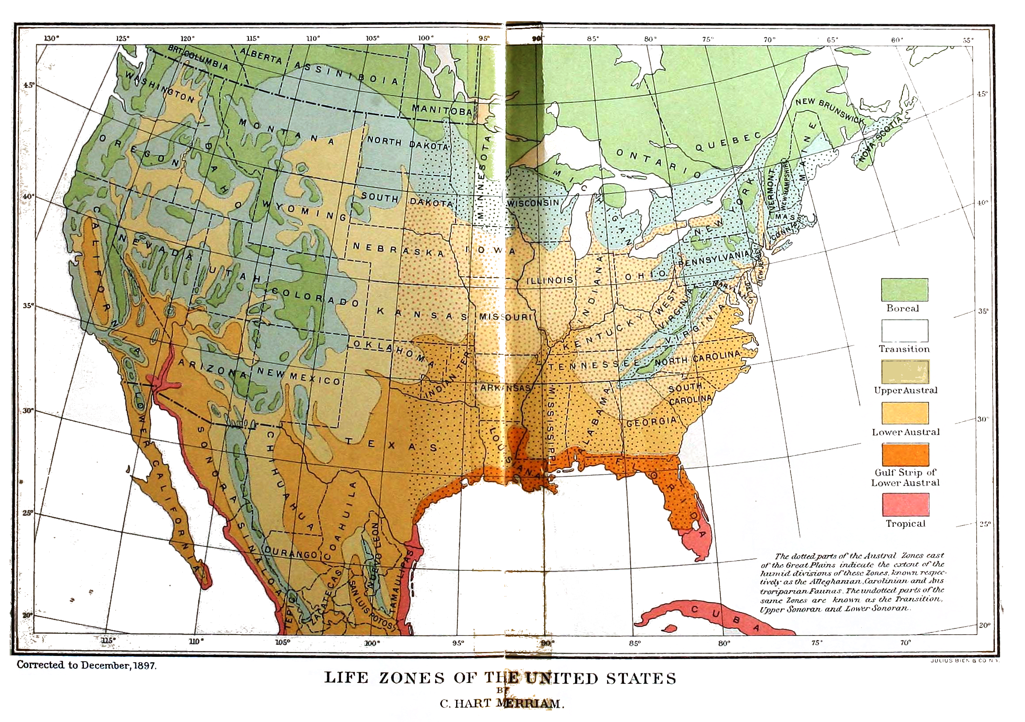
C. Hart Merriam (1855-1942)
American zoologist, mammologist, ornithologist, entomologist, ethnographer, and naturalist.
Developed the life zone concept in 1889: geographic regions are defined by their similar plant and animal communities.
The life zone concept was developed on the San Francisco Peaks (Arizona) and are most applicable to western North America.

Slide 10
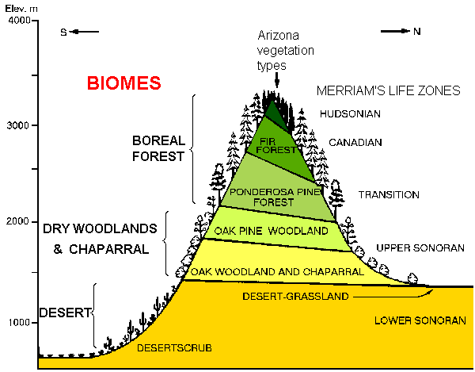
Key Biogeography Concepts
Community: species (plants and animals) that live together in the same place.
Biome: major communities of organisms that occur together at the landscape scale .
Ecosystem: co-occurring species, the physical environment, and all biotic and abiotic interactions.
-Abiotic: non-living parts of the environment.
-Biotic: living parts of the environment.

Slide 11
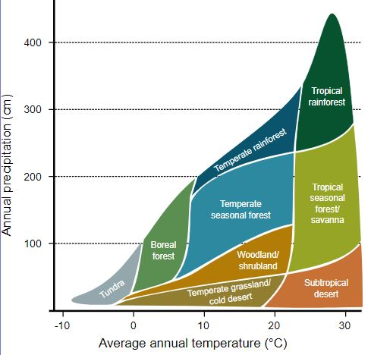
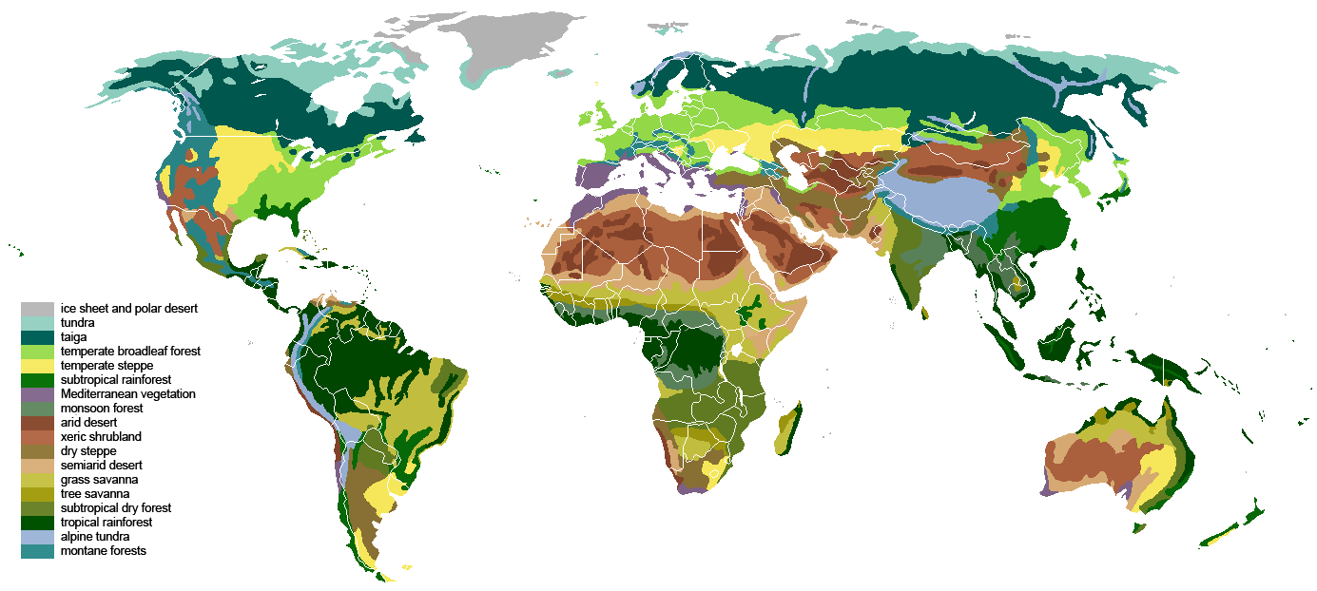
Biogeography Graphs
Climograph
Major terrestrial biomes

Slide 12
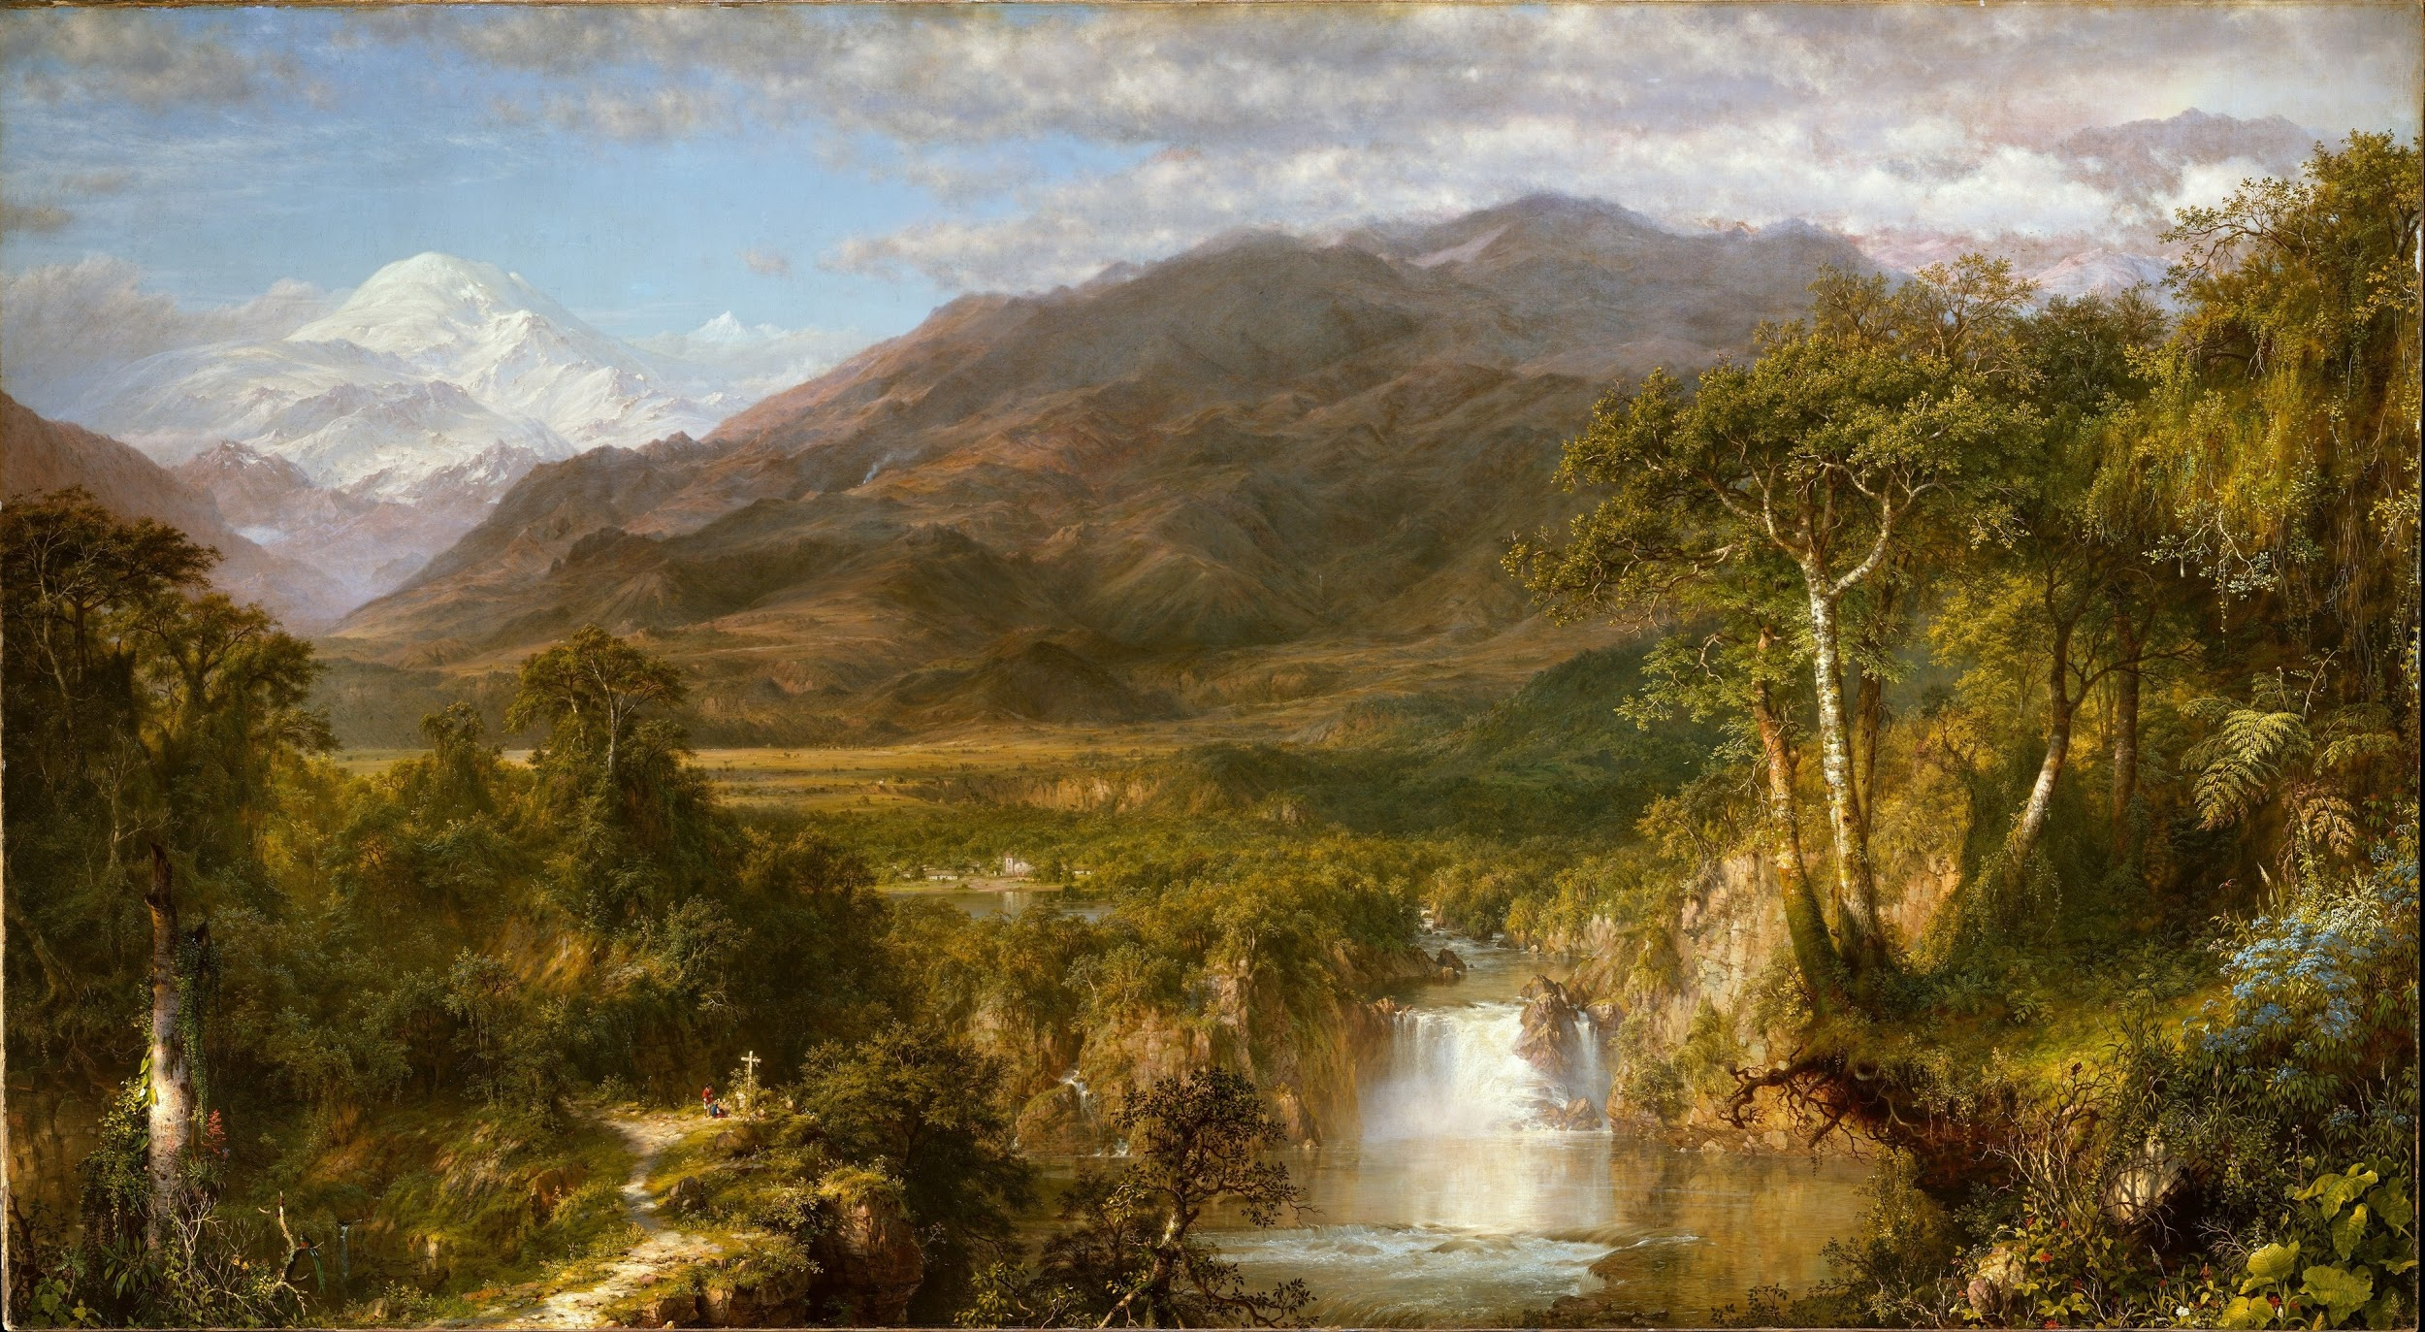
Humphreys Peak Activity
“Humboldt showed eleven zones of plants, along with details of how they were linked to changes in altitude, temperature and so on. All this information could then be linked to the other major mountains across the world.” (Wulf)

Slide 13
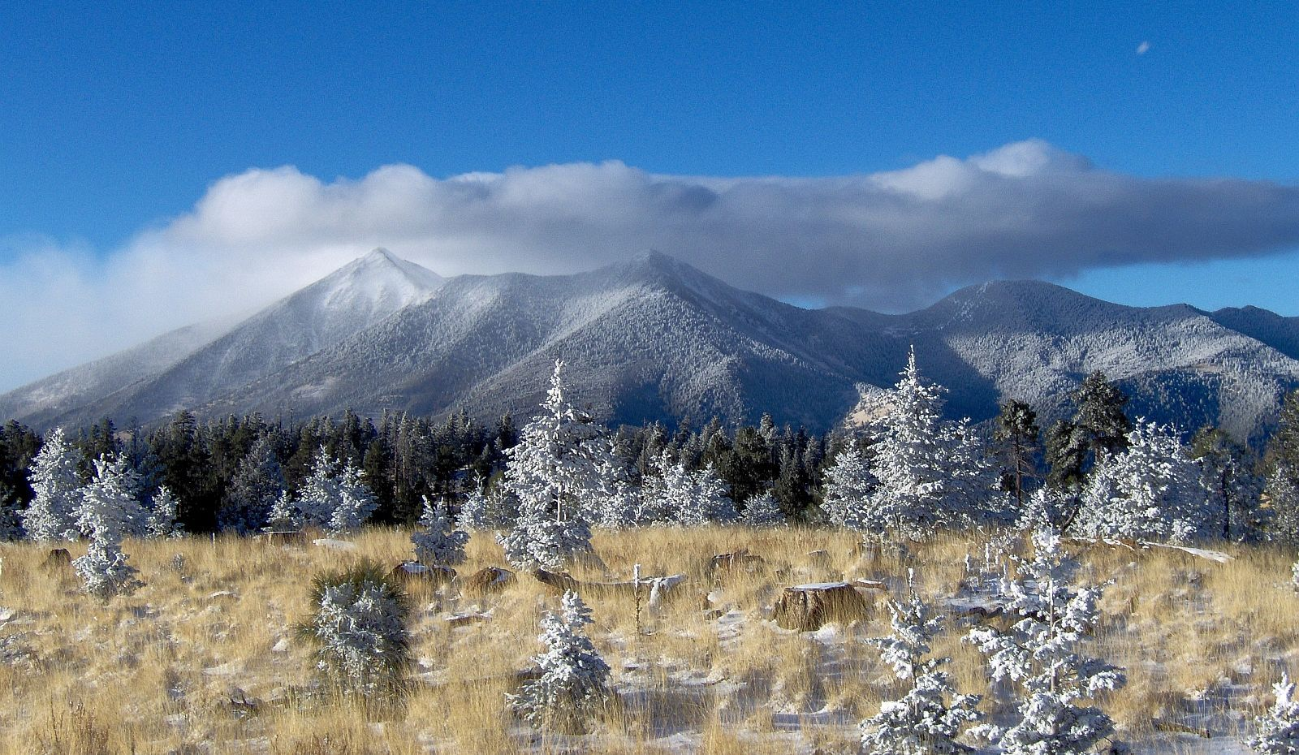
Humphreys Peak Activity
Now it’s your turn!
The year is 2099. Based on the observations made on Mount Chimborazo, predict where the plants on Humphreys Peak in Northern Arizona will be located in 80 years from today.

Slide 14
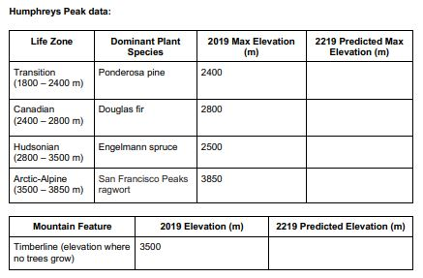
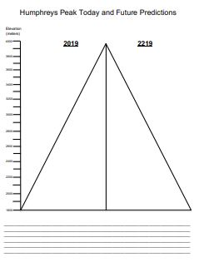
Humphreys Peak
Activity
Predicted increase in mean temperature in the Southwest from 2018-2099 based on a high emission scenario: 7 °F to 15 °F.
Things to think about:
What is different between Mount Chimborazo and Humphreys Peak?
What do you think will happen to the plants in the Arctic-Alpine zone?
Is there anything we can do to stop plants from changing life zones?

Slide 15
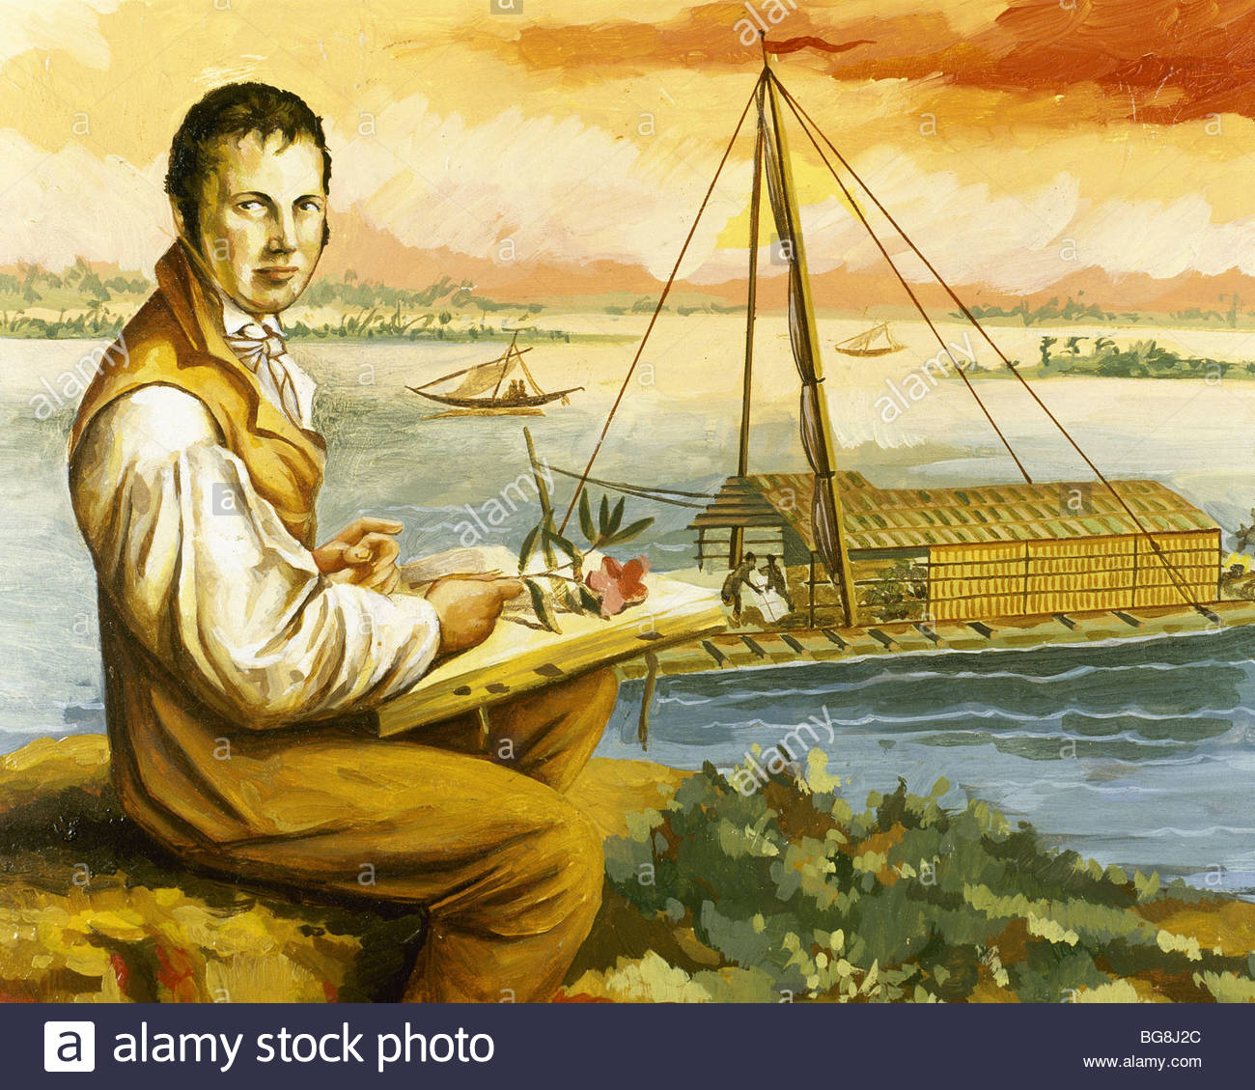
Final thoughts
“Everything that he had ever observed fell into place. Nature, Humboldt realized, was a web of life and a global force. He was, a colleague later said, the first to understand that everything was interwoven as with ‘a thousand threads’. This new idea of nature was to change the way people understood the world.” (Wulf)

